Slide 1
Conversation Café
Program Overview

Slide 2

Conversation Café
What? Quarterly, 60-min. sessions
When? Initiated Q3 2020, 2 events
Where? Virtual (for now)
Who? Content & partner teams
Notes:
The Conversation Café series consists of quarterly cross-vertical working sessions, initiated in Q3 2020. They are all virtual, and present an (optional) opportunity for CS content stakeholders to connect and discuss a work-related focus topic in depth.

Slide 3
Purpose
Input Team A
Input Team B
Input Team C
Invent & Simplify
Connect across verticals
Identify divergences
Promote best practices
Uncover pain points
Brainstorm solutions
Notes:
The purpose is:
- Connect across verticals: build trust, increase familiarity, reduce friction
- Identify divergences: come to a shared understanding of the content space and simplify content management processes
- Promote best practices: encourage cross-pollination of working concepts
- Uncover pain points: identify reoccurring, complex, and oftentimes shared challenges
- Brainstorm solutions: jointly generate new ideas to simplify, unblock and evolve together

Slide 4
The set-up
Flow, Schedule, Tools, Roles

Slide 5
Flow
Introduction
Conversation Loops
Sum-up & Feedback
Evaluation & Follow-up
Phase 1: Introduction of focus topic
Phase 2: Conversation loops (2-3)
Phase 3: Sum-up & feedback
(Phase 4: Evaluation & follow-up)

Slide 6

Schedule (60 min.)
Introduction: 8:00-8:10 am
Topic presentation: 8:10-8:15 am
1st Loop: 8:15-8:30 am
2nd Loop: 8:30-8:45 am
Sum-up & Feedback: 8:45-9:00 am

Slide 7
Tools (internal)
Amazon Chime
Simple Retrospectives
Trawler
Quip
Quip: Agenda, Administration
Amazon Chime: Conversation loops
Simple Retrospectives: Sum-up
Trawler: Feedback survey

Slide 8
Roles
Ringleader
Timer
Note taker
Ringleader: Calls an instant meeting; same for all loops
Timer: Keeps track of time, changes per loop
Note taker: Collects key insights, changes per loop

Slide 9
The outcome
Insights, feedback, reporting

Slide 10
Insights (actions)
Insights to act on (opportunities)
Insights to acknowledge (pain points)
Insights to communicate (best practices)
Categorize by type
Communicate best practices, acknowledge paint points, act on opportunities
Prioritize by # of votes
More votes = increased urgency

Slide 11
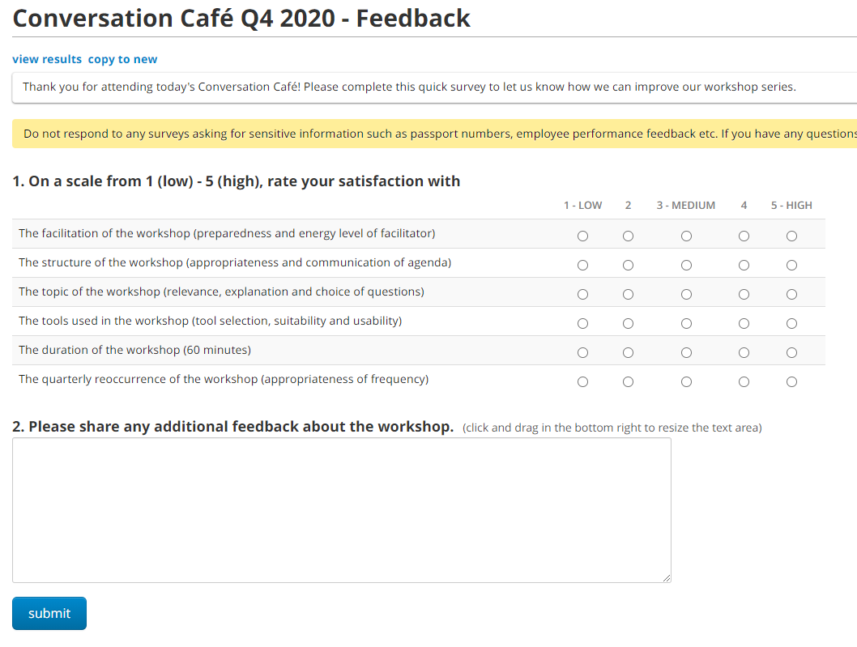
Feedback
Participant data: number of teams/verticals/participants, percentage of increase/decrease
Satisfaction data: Facilitation, structure, tools, topics, duration reoccurrence

Slide 12
Reporting
Participant Data
Cross-vertical representation
Indication of program adoption
Satisfaction Data
Quality rating per valuable/overall
Indication of program quality
Insights Data
Output (# of actionable insights)
Indication of program relevance

Slide 13
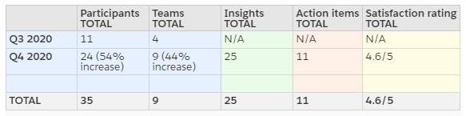
Example Overview

Slide 14
The End
Thanks for listening!

